Slide 1
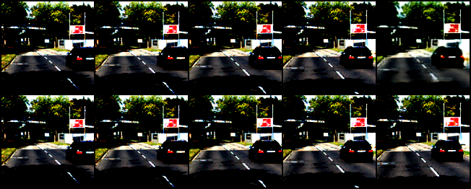
Video Frame Prediction
Prakhar Gupta, Mayuresh Bhosale
PhD Students, AuE

Slide 2
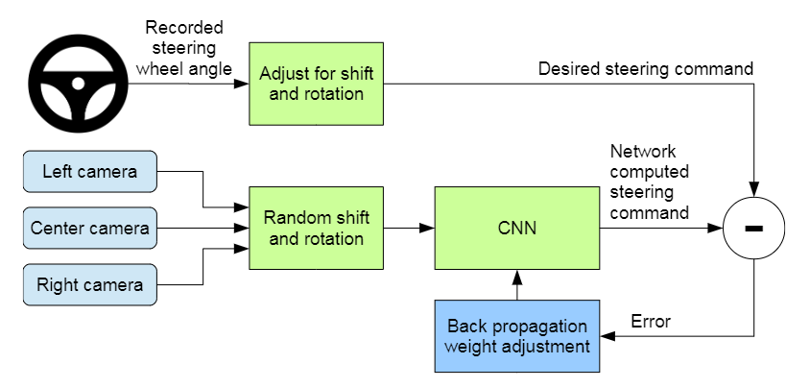
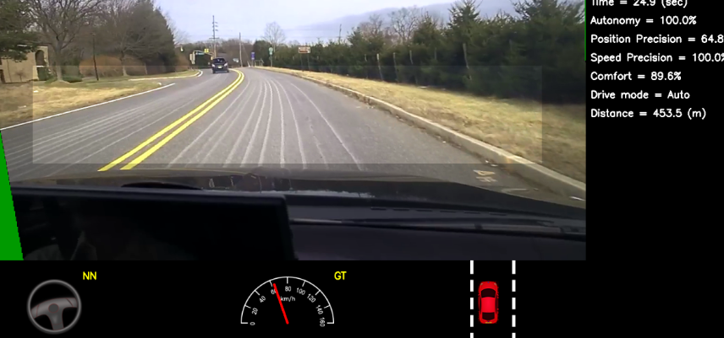
Problem Statement – Video Frame Prediction
Vision-based end-to-end driving can benefit from more accurate scene predictions
Significant research on object tracking.
Proactive planning: Visual prediction for vehicles and pedestrians for safety
Longer prediction windows are susceptible to blurry frames
Question: Can we leverage direct or indirect physics/kinematics constraints to improve uncertainty in the video sequence frame generation?
Bojarski, Mariusz. "End to end learning for self-driving cars." arXiv preprint arXiv:1604.07316 (2016).
Notes:
Autonomous driving and robotics can highly benefit from accurate scene predictions.
There has been significant research in object detection for Avs
Moreover, Proactive planning based on visual predictions of vehicles and pedestrians on the road can highly enhance safety aspect of AVs
Major problem is, long term video prediction and blurriness in the frames Question is: Can we leverage direct or indirect physics/kinematics constraints to improve uncertainty in the video sequence frame generation?

Slide 3
Video Frame Prediction
What is it, and key aspects
Image generation but with an added temporal aspect
Can be conditioned on motion, anatomical, structural constraints
A subset of conditional video synthesis
Popular techniques:
LSTMs, RNNs (PredNet, UNet, MCNET …)
GANs (VGAN, TGAN … )
Denoising Diffusion Models
Video Synthesis
Unconditional
Motion (Physics)
Structure
Conditional (More Control)
... etc.
Notes:
If we look at the video frame prediction history.
Two aspects in video synthesis, unconditional and conditional where constraints give more control in prediction
Popular techniques are LSTMs, RNNs, GANs, Diffusion models

Slide 4
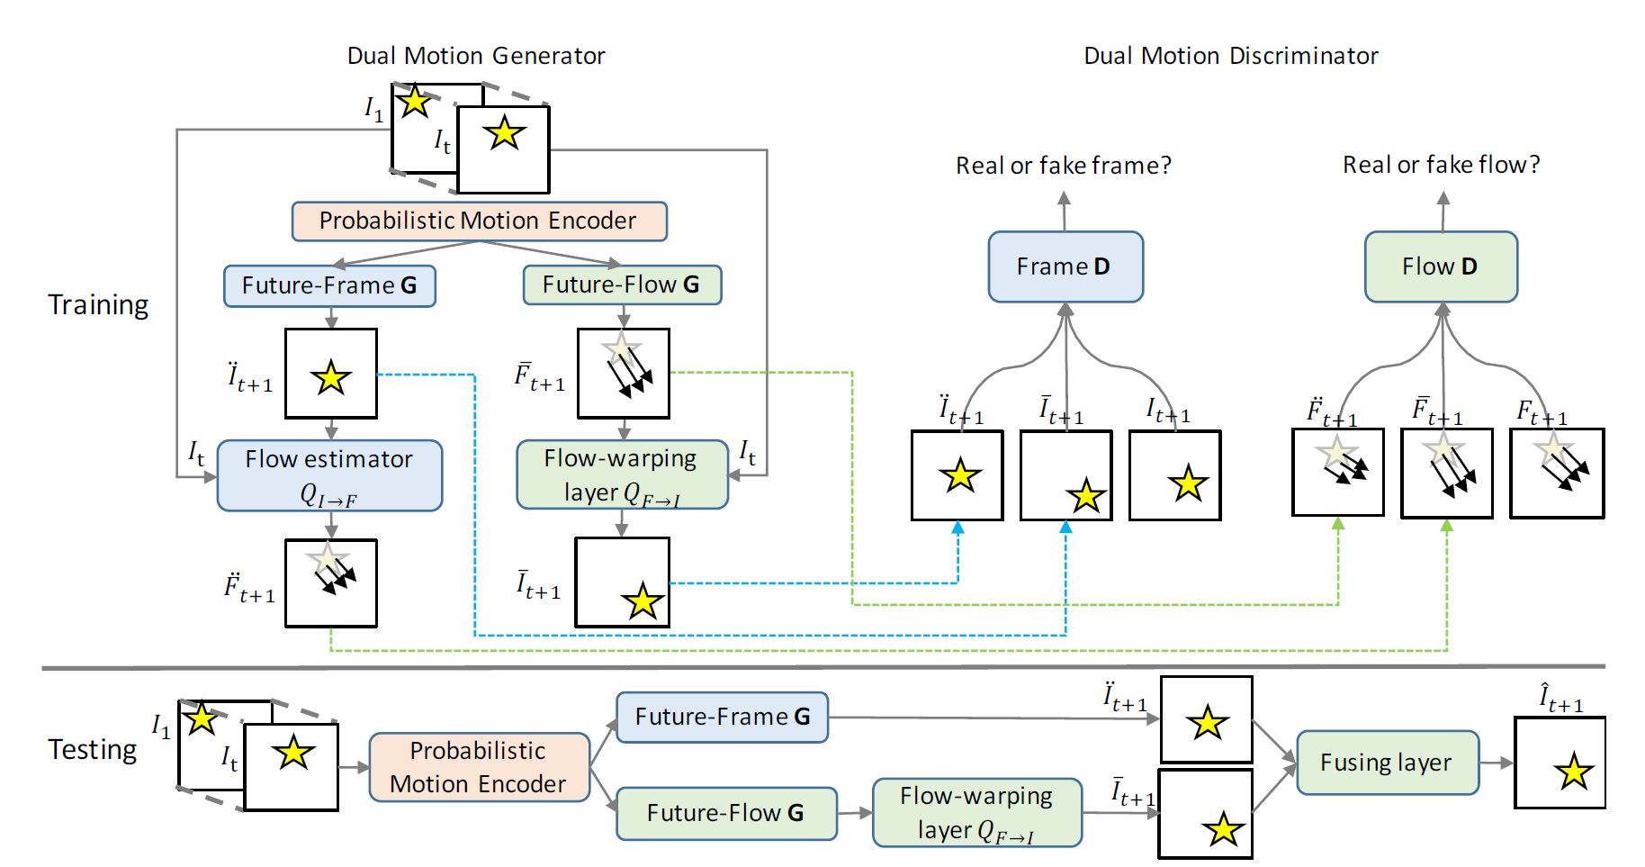
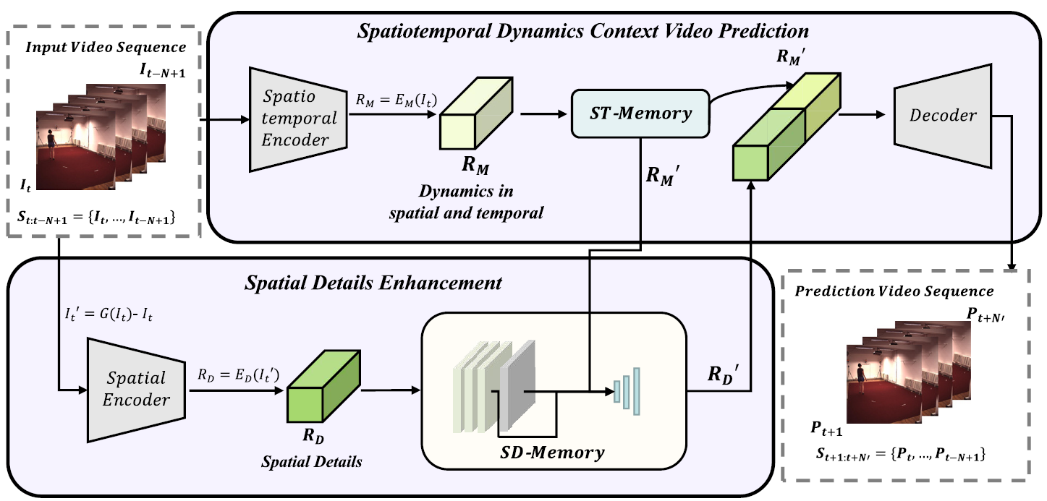
Related Work:
Dual Motion GAN – Future-Flow Video Prediction
DANet: Dynamics aware video prediction
Two-branch video prediction model to jointly model the spatiotemporal dynamics and spatial details
Spatio-Temporal Memory to transmit the spatiotemporal features of video along a zigzag direction across the MotionCells
Dual Learning Mechanism, Each generator's output refines the other's predictions through a shared probabilistic motion encoder
Common Limitation: Pixel hallucinations and long-term blurry video predictions
Liang, Xiaodan, et al. "Dual motion GAN for future-flow embedded video prediction." proceedings of the IEEE international conference on computer vision. 2017. (433 Citations)
Huang, H., & Guan, Y. (2024). DANet: A spatio-temporal dynamics and Detail Aware Network for video prediction. Neurocomputing, 128023
Notes:
GAN and autoencoder approach (LSTM) Either based on flow predictions and/or decomposition of motion sequence and object background
Both have limitations, common are pixel hallucinations long term blurriness

Slide 5
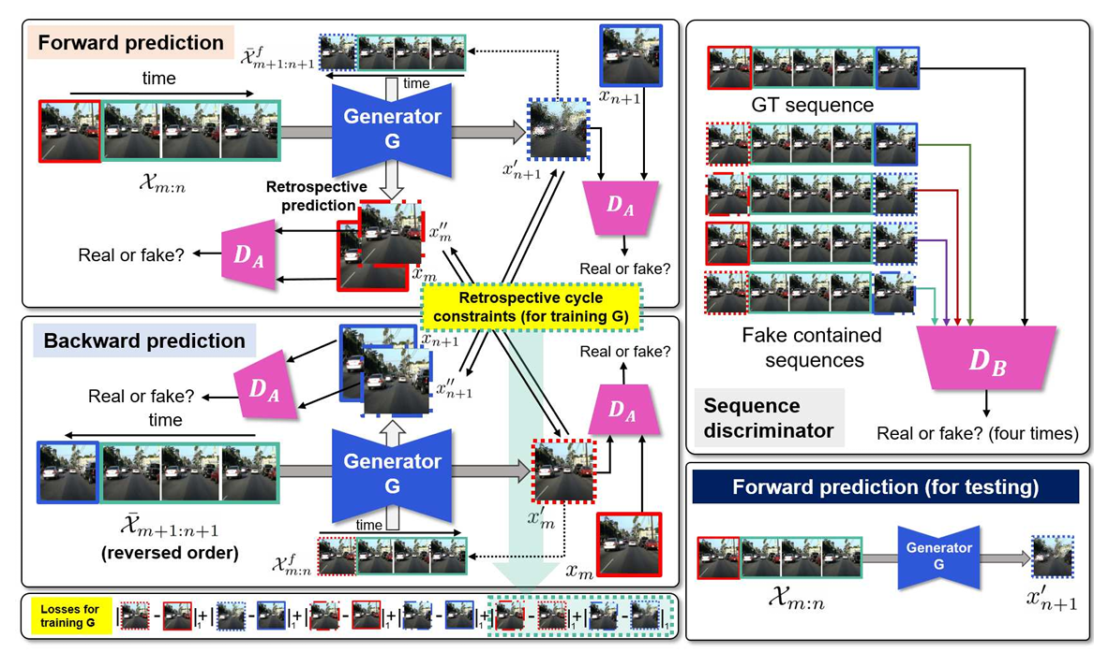
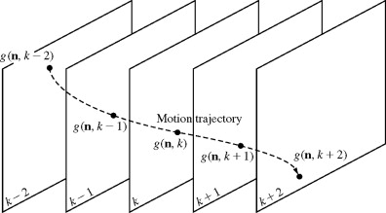
Related Work:
Predicting Future Frames using Retrospective Cycle GAN
Generate past AND future frames
Ensure temporal consistency with past + future
Two discriminators
Single Frame
Sequence
Kwon, Y. H., & Park, M. G. (2019). Predicting future frames using retrospective cycle gan. In Proceedings of the IEEE/CVF Conference on Computer Vision and Pattern Recognition (pp. 1811-1820).
Notes:
Addressed the problem of longer prediction better by backward and forward direction of video sequence prediction
Enforced temporal consistency in predictions

Slide 6
Related Work
Predicting Future Frames using Retrospective Cycle GAN
$$l=L_{image}+ λ_{1}L_{LoG}+λ_{2}L_{frame}^{Adv}+λ_{2}L_{seq}^{Adv}$$
Room to improve blurring
Conditioning the GAN on physics and flow can provide more control over generations
Notes:
Reconstruction loss image, Laplacian operator – for edge detection,
Gaussian smoothing makes edge detection more robust by focusing on significant changes in intensity rather than noise.
Room for blurring as we can see
Question: Can we leverage direct or indirect physics to improve the image quality or reduce blurring in long term prediction
First aspect: using bounding box tracking information to enforce motion constraint equations
This would need object detection implementation for new generated frames from the generator over the existing information.
Faced implementation challenges so imposed physics constraints indirectly.
Second aspect: use indirect physics implementation

Slide 7
Approach 1:
Unique feature: Conditioning Retrospective GAN on Flow
Loss:
Optical Flow computation during training using pre-trained RAFT model (RAFT: Recurrent All-Pairs Field Transforms for Optical Flow)
Has proven performance and generalization on KITTI data
Large model with higher accuracy was utilized
$l=L_{image}+ λ_{1}L_{LoG}+λ_{2}L_{frame}$ + $λ_{3}L_{sequence}$ + $λ_{4}L_{flow}$
[Teed et al, Princeton]
Notes:
Two approaches, first aimed to use optical flow information as indirect object tracking constraint in the loss function of generator
Pretrained RAFT model used to compute optical flow between images
RAFT framework predicts optical flow by iteratively refining the flow field using a correlation volume and a recurrent network.

Slide 8
Approach 1:
Unique feature: Conditioning Retrospective GAN on Flow
Motivation: Instead of bounding box tracking, use optical flow difference
$L_{flow}=Σ(λ_{flow}⋅{\left|\left|F_{s} −F_{s}^{GT}\right|\right|}_{2})$
We emphasize only on the 4th to 5th frame flow loss compared to ground truth.
Notes:
Lflow is difference in GT and predicted image flow sequence
Used this flow only 4 to 5th image due to blurriness in predictions

Slide 9
Approach 2:
Unique feature: Adding kinematic constraints to retrospective GAN
Loss:
Reconstruction loss for each frame:
Minimize errors in forward and backward directions
Network Architecture:
One Generator with generating forward and backward video sequences
Two discriminators, first for details in a single/individual frame and second to evaluate the frame sequences
$l=L_{image}+ λ_{1}L_{LoG}+λ_{2}L_{frame}$ + $λ_{3}L_{sequence}$ + $λ_{4}L_{velocity}$ + $λ_{5}L_{acceleration}$
Laplacian of Gaussian for preserving edges based on rapid intensity changes
Notes:
Second approach: indirect physics based prediction through the velocity and acceleration constraints

Slide 10
Approach 2:
Unique feature: Adding kinematic constraints to retrospective GAN
Loss:
$l=L_{image}+ λ_{1}L_{LoG}+λ_{2}L_{frame}$ + $λ_{3}L_{sequence}$ + $λ_{4}L_{velocity}$ + $λ_{5}L_{acceleration}$
Change in pixel positions in consecutive frames
Change in pixel velocities in consecutive frames
Input: A sequence of frames $x_{1}, x_{2}, …,x_{T}$ which are stacked frames with RGB values
Output: Predicted frame $x_{t+1}, x_{t+2}, …,x_{t+..}$ that maintains the details and motion in the frames
Important design choice: adding kinematic constraints to the generator to enforce temporal and motion based structural consistency

Slide 11
Implementation
Cropped and downsized images to 128x128 from KITTI Raw dataset for city driving
Normalization leads to improved learning performance
Very small images and batch sizes (18 sequences) to accommodate 16GB memory for V100 GPU.

Slide 12
Results
Three models are run
Baseline Retrospective Cycle GAN (RCGAN)
Optical Flow Conditioned RCGAN
Kinematics Conditioned RCGAN
Approach 3: Flow + Kinematics Conditioned RCGAN

Slide 13
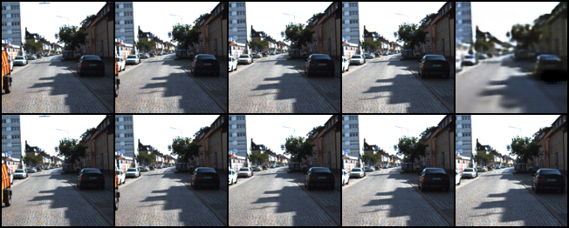
Results
Epoch 10
Predicted Sequence on top
Baseline
Future frames along time
Ground Truth sequence at bottom
For Validation sequence 1
For Validation sequence 2

Slide 14
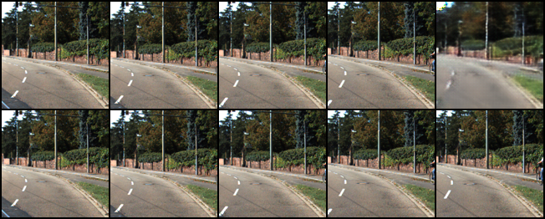
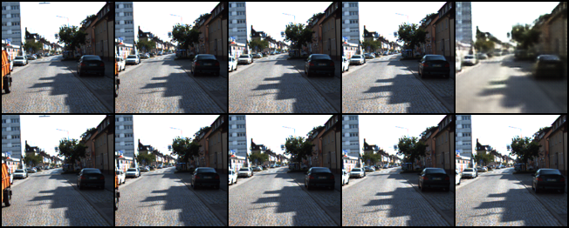
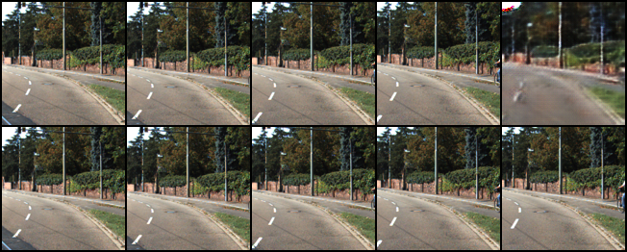
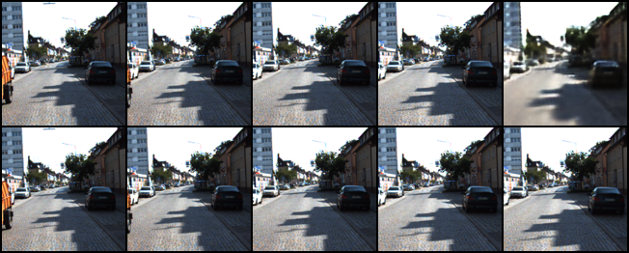
Results
Epoch 10
Baseline
Future frames along time
RAFT Flow Conditioning
Kinematics Conditioning

Slide 15
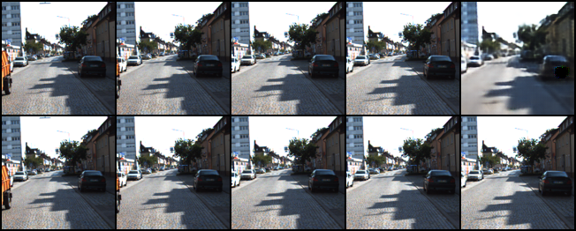
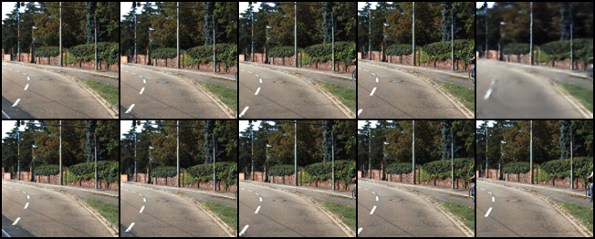
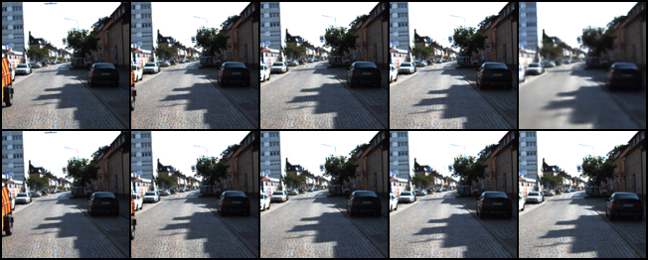
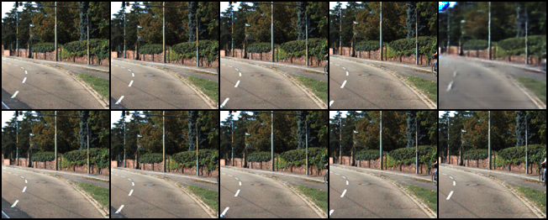
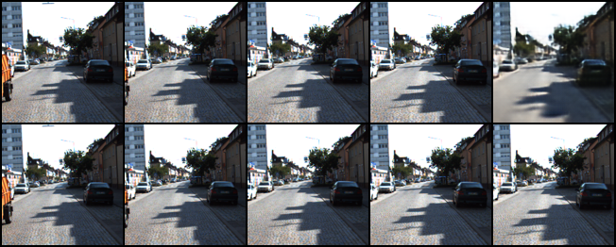
Results
Epoch 30
Baseline
RAFT Flow Conditioning
Kinematics Conditioning

Slide 16
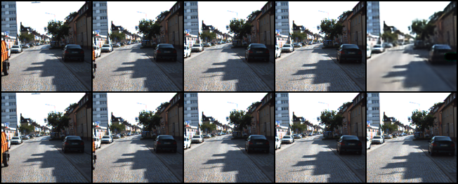
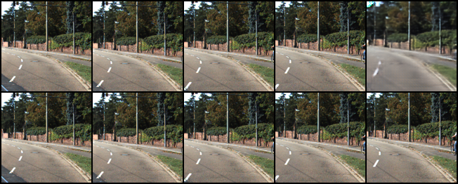
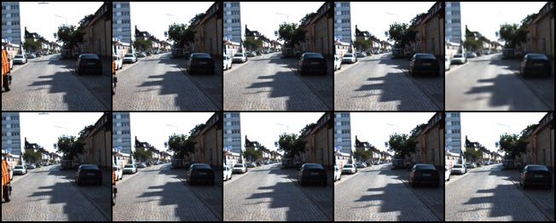
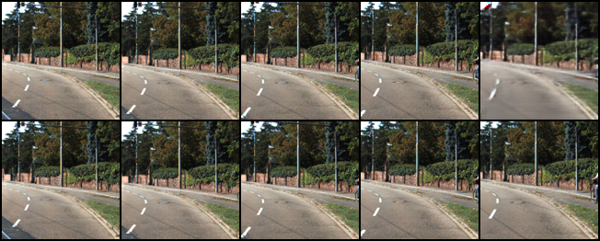
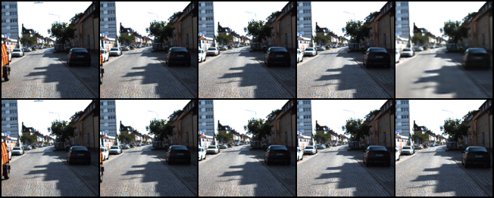
Results
Epoch 50
Baseline
RAFT Flow Conditioning
Blurring reduced already
Kinematics Conditioning

Slide 17
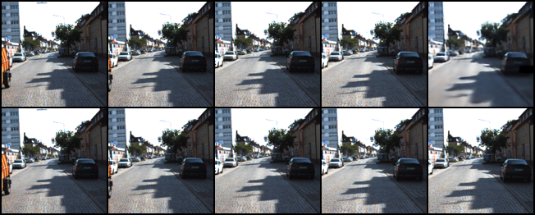
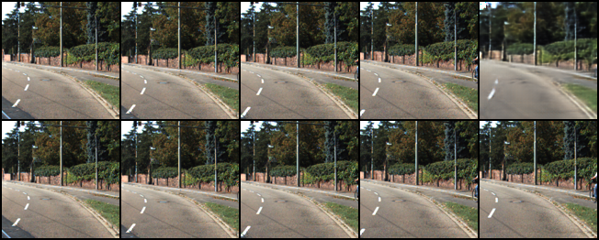
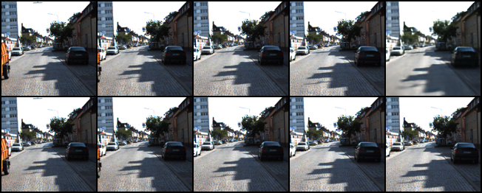
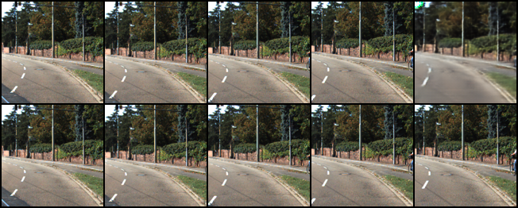
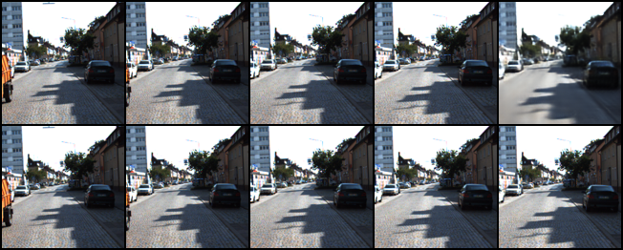
Results
Epoch 75
Baseline
RAFT Flow Conditioning
Kinematics Conditioning

Slide 18
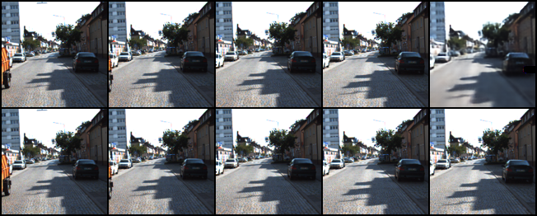
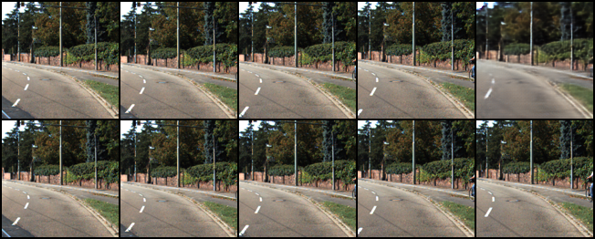
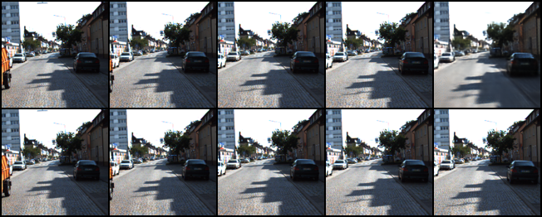
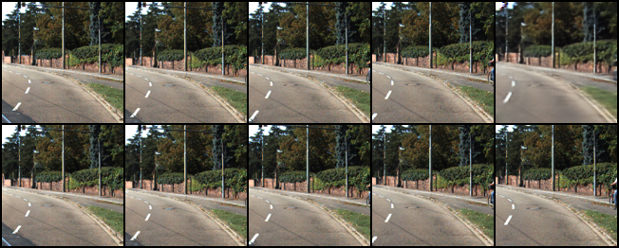
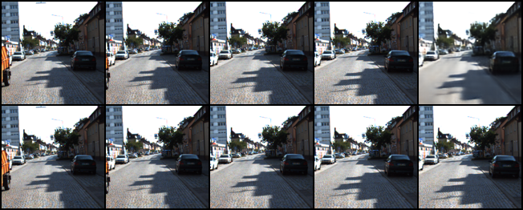
Results
Epoch 100
Baseline
RAFT Flow Conditioning
Kinematics Conditioning

Slide 19
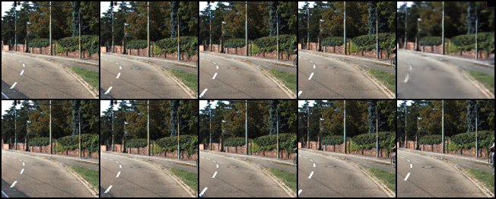
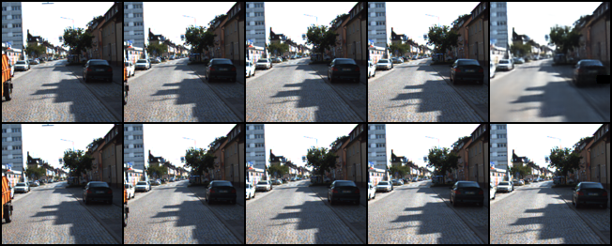
Results
Epoch 100
Baseline
Flow + Kinematics Conditioning
Kinematics Conditioning

Slide 20
Baseline
RAFT Flow Conditioning
Kinematics Conditioning
Flow + Kinematics Conditioning

Slide 22
Results
More Artifacts from Approach 2 (Kinematics conditioning)
Lower Blurring compared to baseline for the last frame

Slide 23
Results
Qualitative Analysis: Totals and averages for validation data sequences
Approximate trends over ~70 sequences from validation dataset
Epoch 10
 | Baseline | Approach 1 | Approach 2 | Approach 3
PSNR | 22.09 | 22.95 | 23.22 | 22.66
SSIM | 0.719 | 0.763 | 0.764 | 0.737
MSE | 6.29 | 5.26 | 4.83 | 5.46
Epoch 100
 | Baseline | Approach 1 | Approach 2 | Approach 3
PSNR | 23.76 | 26.20 | 25.43 | 25.93
SSIM | 0.79 | 0.85 | 0.839 | 0.838
MSE | 4.49 | 2.48 | 3.10 | 2.647

Slide 24
Conclusion, Limitations, & Future Work
Conclusion:
We attempt indirect physics conditioning for temporal cycle GAN
Two approaches improve over baseline’s predictions:
Laplacian of Gaussian loss function with kinematics had marginally clearer predictions for the later frames
Improvement in realism/blur due to addition of optical flow condition to the RCGAN
Physics consistency:
Kinematic loss or optical flow in GAN imposes indirect physical constraints on the video behavior leading to the video sequence prediction.
Combined Approach:
For the same epochs of training, combined approach doesn’t yield as good results as Kinematics only conditioning. Since there are more variables in the loss function, it needs more training.
Future Work:
Localized motion constraints: Add object detection and tracking using KITTI tracklets; apply differential physics-based constraints to only localized pixels to predict motion of other vehicles and pedestrians on the road
Longer term prediction: Essential to predict longer video frame sequences for various applications as robotics

Slide 25
End
Questions?

Slide 26
Future Work
Limitations: Long term prediction
Add object detection and apply physics-based constraints to only localized pixels to predict motion of other vehicles and pedestrians on the road
Add filtering to estimate the changes in the vehicle or pedestrian positions and utilize it in the prediction framework

Slide 27
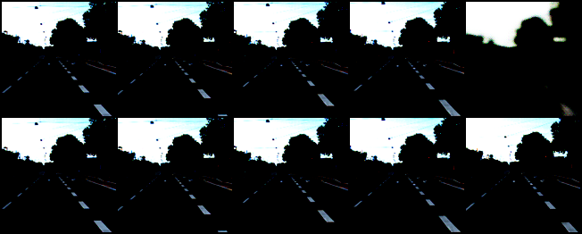
Experimental Results
With Kinematics embedded in loss function
Epoch 1
t = 1 t = 2 t = 3 t = 4 t = 5
Predicted
Ground Truth

Slide 28
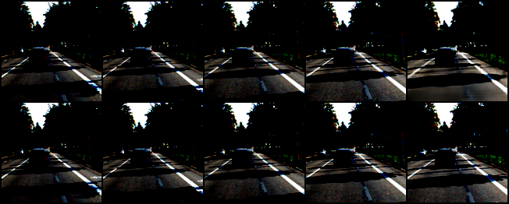
Experimental Results
With Kinematics embedded in loss function
Epoch 100
t = 1 t = 2 t = 3 t = 4 t = 5
Predicted
Ground Truth

Slide 30
fake_21295

Slide 31
fake_21071

Slide 32
fake_20175

Slide 33
fake_18607

Slide 34
Results
Qualitative Analysis: Totals and averages for validation data sequences
Seq 1
Seq 2
Epoch 10
 | Baseline | Approach 1 | Approach 2
PSNR | 18.01 | 17.81 | 17.93
SSIM | 0.506 | 0.495 | 0.5047
MSE | 17.71 | 19.60 | 18.04
Epoch 10
 | Baseline | Approach 1 | Approach 2
PSNR | 22.09 | 22.95 | 23.22
SSIM | 0.719 | 0.763 | 0.764
MSE | 6.29 | 5.26 | 4.83
Epoch 100
 | Baseline | Approach 1 | Approach 2
PSNR | 19.729 | 22.05 | 22.38
SSIM | 0.608 | 0.709 | 0.715
MSE | 13.96 | 7.796 | 6.653
Epoch 100
 | Baseline | Approach 1 | Approach 2
PSNR | 23.76 | 26.20 | 25.43
SSIM | 0.79 | 0.85 | 0.839
MSE | 4.49 | 2.48 | 3.10

Slide 35
Results
Epoch 100
$l=L_{image}+ λ_{1}L_{LoG}+λ_{2}L_{frame}$ + $λ_{3}L_{sequence}$
+ $λ_{4}L_{velocity}$ + $λ_{5}L_{acceleration}$+ $λ_{6}L_{flow}$
Baseline
Flow + Kinematics Conditioning
Kinematics Conditioning

